Slide 1


Data Visualization Techniques

Slide 2

Structure of class
In today’s class we will cover:
Data Visualization Techniques
Chart selection and creation
Story-Telling with Dashboards

Slide 3

Questions are not for the end!!!

Slide 4
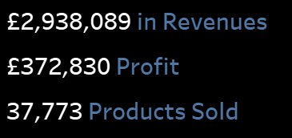
Visualization Techniques – Text KPI’s
KPI: Key Performance Indicator
Understandable by the business
Easy to Interpret and memorize
Straight to the Point

Slide 5
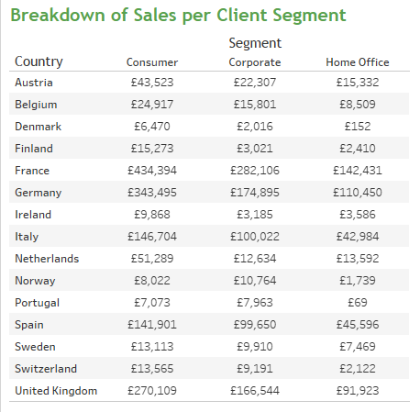
Visualization Techniques – Tables
The most common data visualization technique
Contains all the information within the desired level of granularity
Powerful when several KPI’s are combined

Slide 6
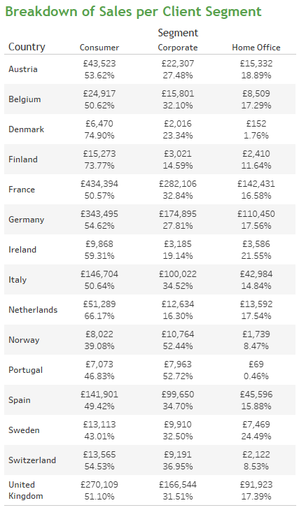
Visualization Techniques – Tables
The most common data visualization technique
Contains all the information within the desired level of granularity
Powerful when several KPI’s are combined

Slide 7
Visualization Techniques – Tables
Some Disadvantages:
Can become too cumbersome
Too many rows due to high cardinality in data
Hard for observer to detect most relevant points
Some tricks can be used to overcome this

Slide 8
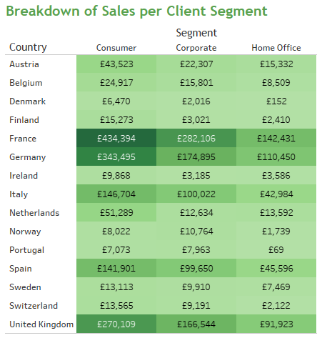

Visualization Techniques – Tables
Combining tabular for of data with colour to highlight the measure being shown.
Yields a head map which contains the same information as the simple data, in a structures form, but with the emphasis in the biggest values.

Slide 9
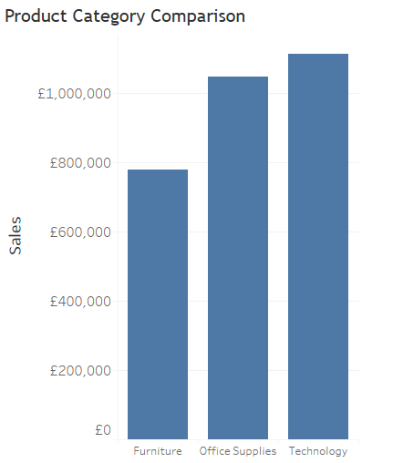
Visualization Techniques – Bar Charts
Bar Charts
Internationally Standard
Visual Comparisons Possible
Can be used for temporal evolution or categorical comparison
Vanilla Bar Chart Breadown by one dimension & one measure shown

Slide 10
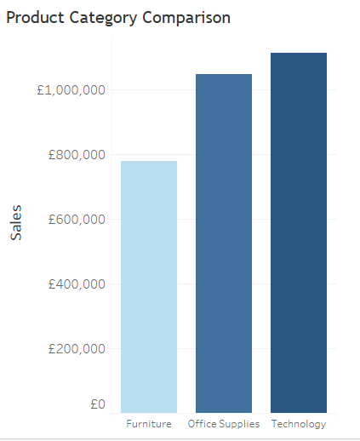

Visualization Techniques – Bar Charts
Bar Charts
Measure in the colour
Helps highlight sizes of quantities
Good for message emphasis
Continuous Colouring Scale
Legend eases compreension

Slide 11
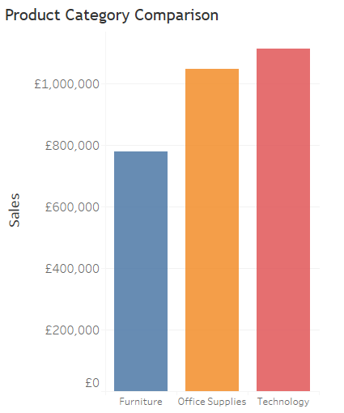

Visualization Techniques – Bar Charts
Bar Charts
Dimension in Colour
Same dimension is redundant information.
Can be valuable to emphasize categorical variables and/or hide text

Slide 12
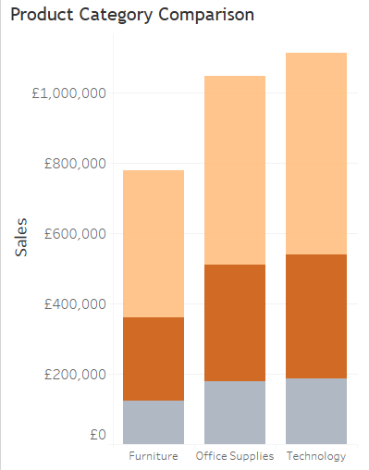

Visualization Techniques – Bar Charts
Bar Charts
Dimension in Colour
Different dimension than breakdown
Changes the level of granularity of visualization
Very powerful to give further insights
Can become overwelming

Slide 13
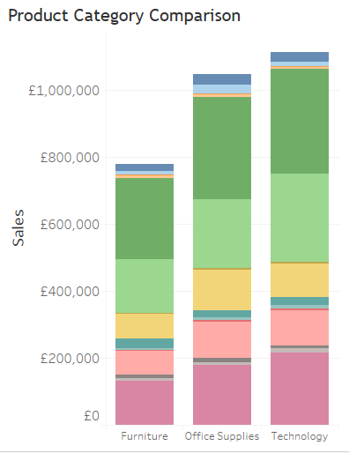
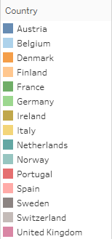
Visualization Techniques – Bar Charts
Bar Charts
Dimension in Colour
Different dimension than breakdown
Changes the level of granularity of visualization
Very powerful to give further insights
Can become overwelming

Slide 14
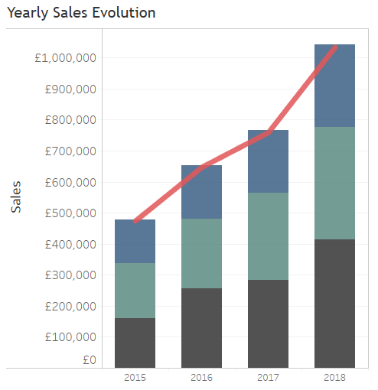

Visualization Techniques – Time Series
Time Series
Chronological in nature – direction matters
Performance tracking
Granularity of time window (daily, monthly, quarterly etc.)
2 possible views: Chronological view vs seasonal view
Dashboard should contain at least 1 time series

Slide 15
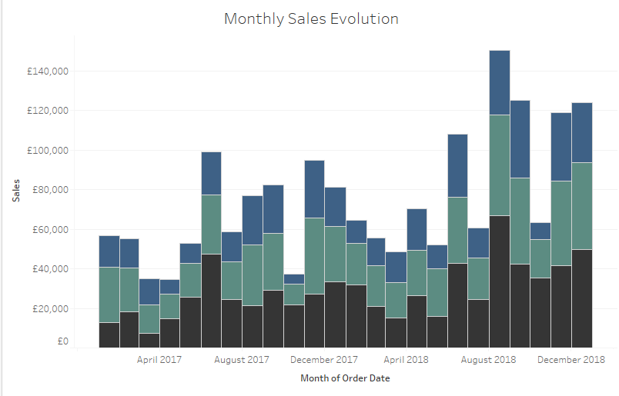
Visualization Techniques – Time Series
Time Series – chronological view
2 years worth of data plotted with a monthly granularity
Only absolute values are shown
Chronological view (left to right time is increasing)
Good to observe overall macro movements/trends and spot outliers

Slide 16
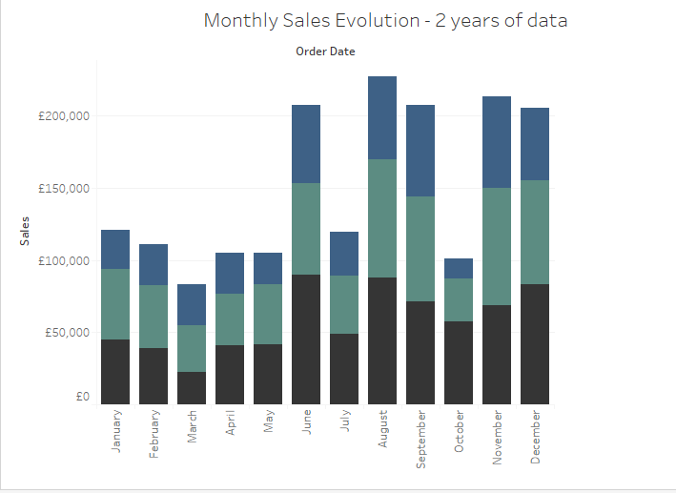
Visualization Techniques – Time Series
Time Series – Seasonal view
2 years worth of data show but on a monthly periods
Each month represents the sum of the sales for that month, during the past two years
Loss of Chronological view
Good to spot seasonalities, smooth out outlier months and detect strongest periods within a repeating period

Slide 17
Visualization Techniques – Pie Charts
General Rules for Pie Charts
Don’t use Pie Charts ☺
If you must break the rule #1 then:
Make sure it adds up to 100%
Use few categories
Start at noon and move clockwise
Largest to smallest values (usually)
Include labels for % and absolute values if possible
Avoid 3D

Slide 18
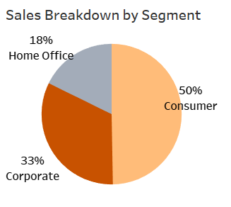

Visualization Techniques – Pie Charts
Pie Charts
Breakdown by one dimension.
Angle of slice in pie represents proportion of total for that measure
Normally used to represente percentages. Stronger than Bar Charts for this use.
Allows for a very fast conclusion to be drawn in a visual way.

Slide 19
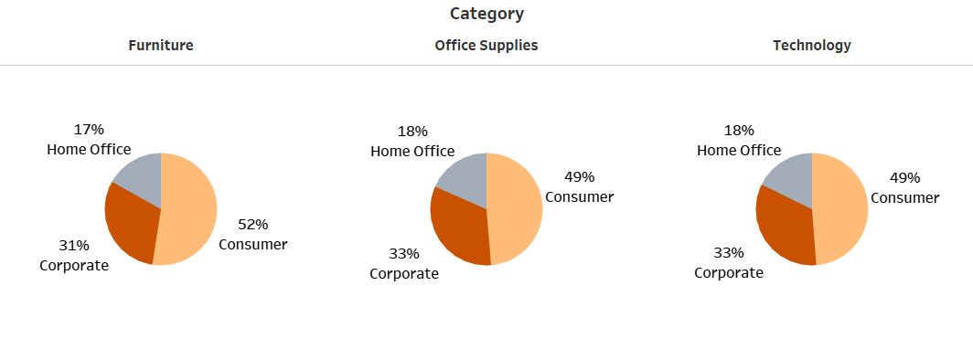
Visualization Techniques – Pie Charts
Pie Charts
Greater breakdown of another dimension allows to create one pie chart per value
What alternative measure com be used here to make pie charts comparable?

Slide 20
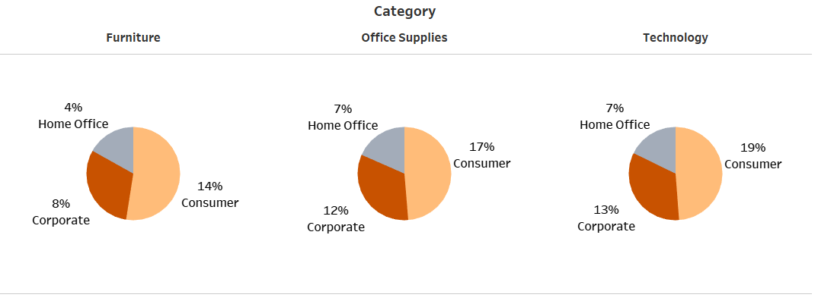
Visualization Techniques – Pie Charts
Pie Charts
Greater breakdown of another dimension allows to create one pie chart per value
Percentage displayed reveals % of sales compared to all categories.

Slide 21
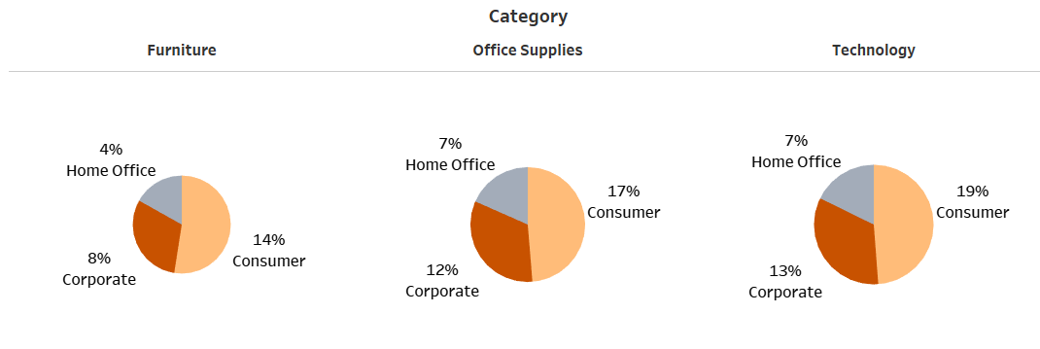
Visualization Techniques – Pie Charts
Pie Charts
Size of the Pie’s can be used to encode total sales of that breakdown
What is the granularity of this visualization?

Slide 22
Visualization Techniques – Scatter plots
Scatter Plots
Include a minimum of 2 measures (x,y)
Dimension/Measure can be encoded in colour of each point
Useful to detect clusters/segmentation
Commonly used to compare variables like Volume/Revenue vs frequency/# occurences
Granularity of visualization will determine the number of points (what does each point represent?)

Slide 23
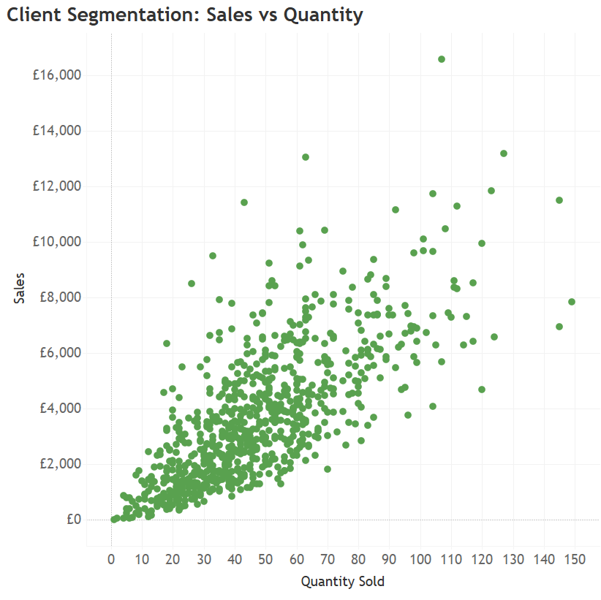
Visualization Techniques – Scatter plots
Scatter Plots
Each point represents a client
Colour means nothing
Easy to spot outliers

Slide 24
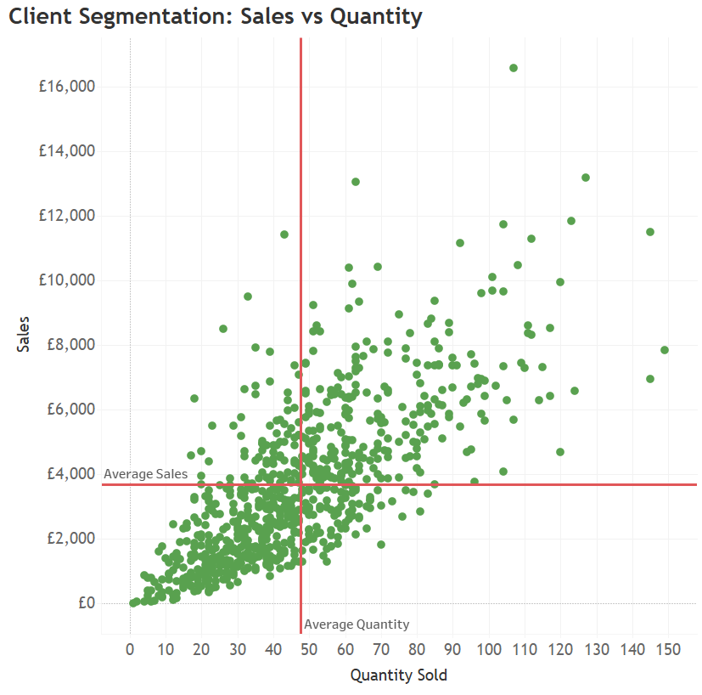
Visualization Techniques – Scatter plots
Scatter Plots
Reference lines can be included to help categorize clientes
Average is simple to understand and is a good measure of the “Center” of the data
Average is simple to compute, but we could equally use confidence intervals, Standard Deviation or Inter-quartile range to spot outliers.
Effective categorization into 4 quadrants

Slide 25
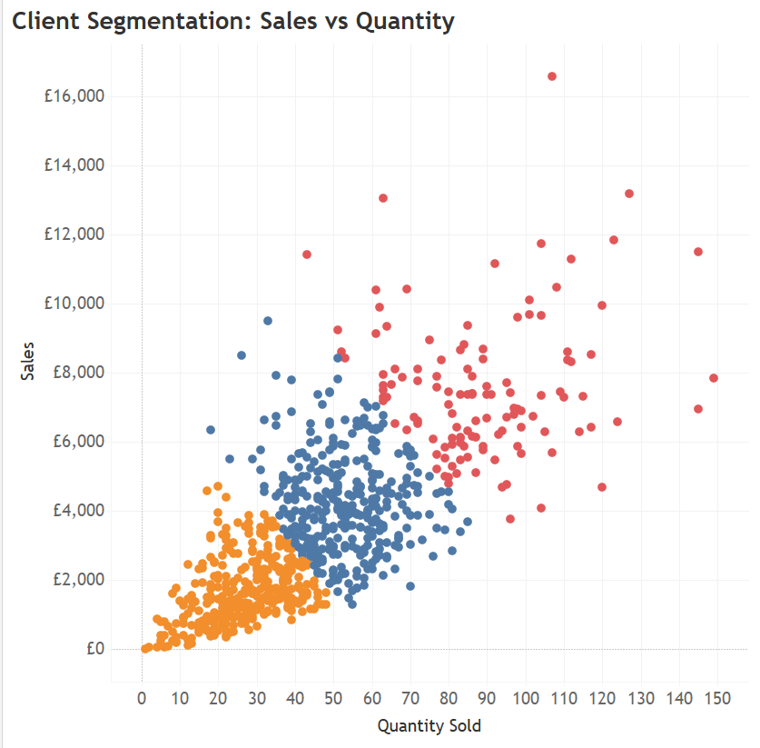

Visualization Techniques – Scatter plots
Scatter Plots
Advanced methods can be employed to create cliente clusters
When a new client is onboarded to the company, he will fall into one of the 3 clusters
What further analytics could we apply to understand the clusters?

Slide 26
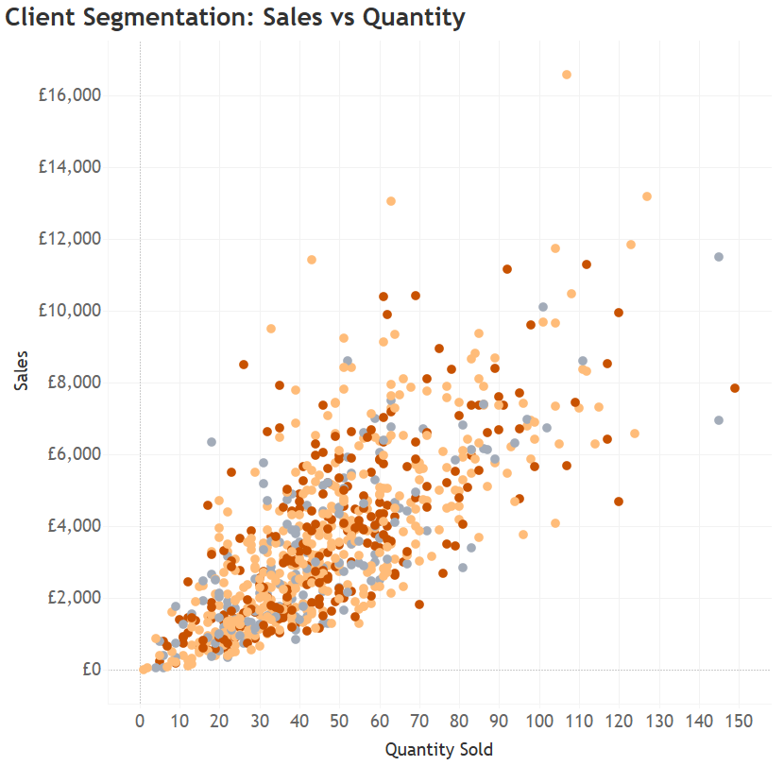
Visualization Techniques – Scatter plots
Scatter Plots
The colour can also be used to represent the value of another dimension/measure associated to the point.
In this case, we use the colour to show the cliente segment (another column within the data)

Slide 27
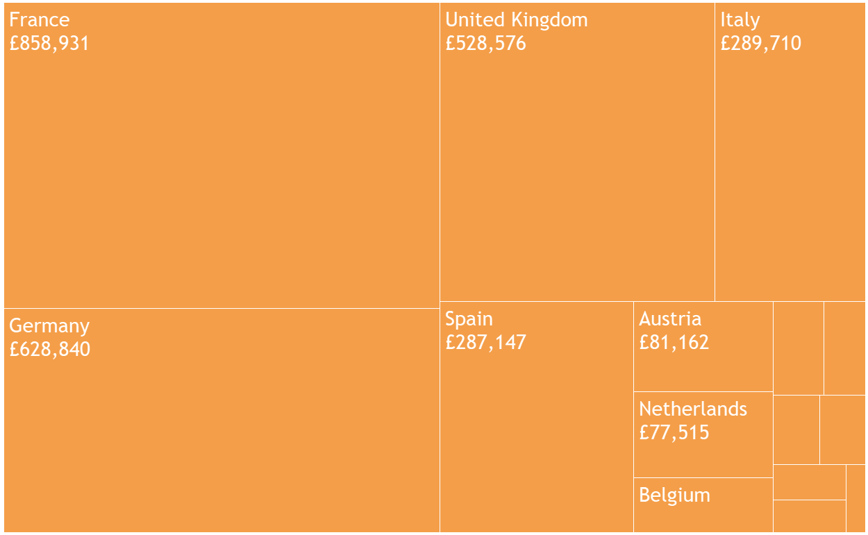
Visualization Techniques – Tree Map
Size of block shows magnitude of measure displayed (in this case sales)
Strong visual impact for comparing different instances within the same variable (comparing sales of different countries)
In large blocks, extra information can be included in a clean way for the user (value of sales, profit, margin etc)

Slide 28
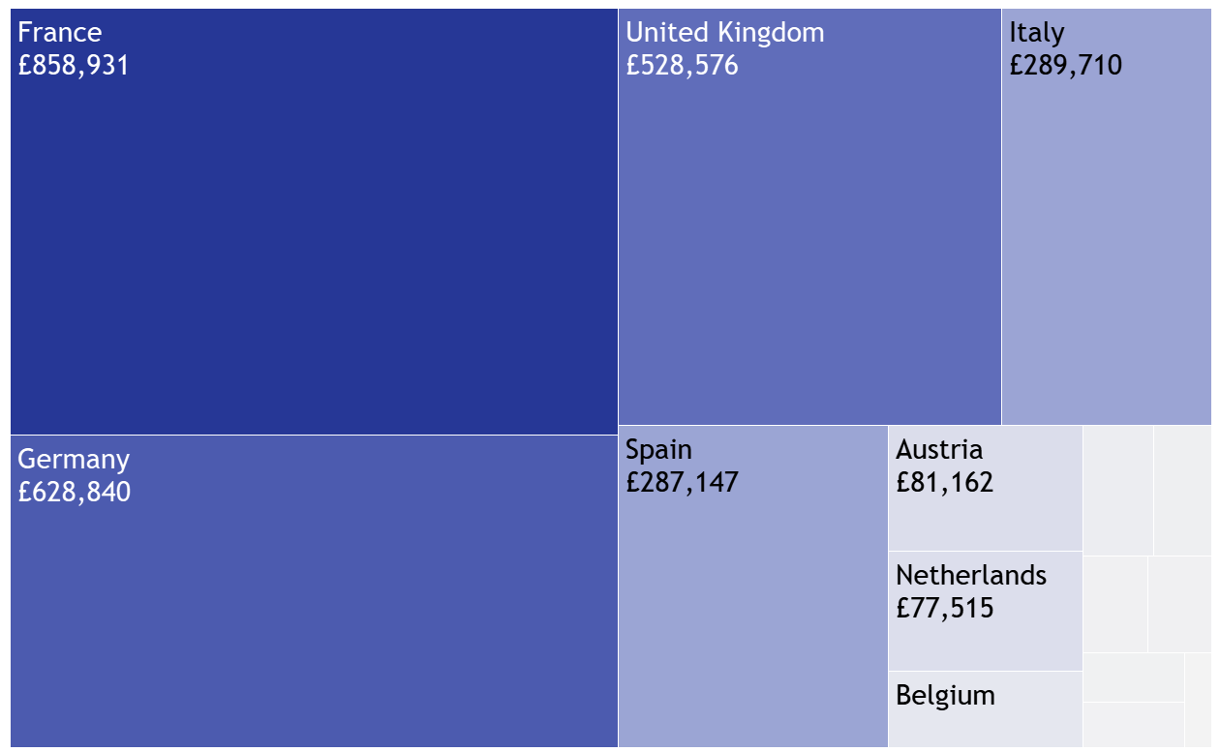
Visualization Techniques – Tree Map
Colour can be used to represent a measure making a treemap into a heat map
Colour and size of block contain the same information (a bit redundant), however this emphasis the biggest players, which can be interesting
Disadvantage of treemap: neglects smallest values of the dimension (countries with smallest revenues) – tends to emphasize the top performers and not the bottom.

Slide 29
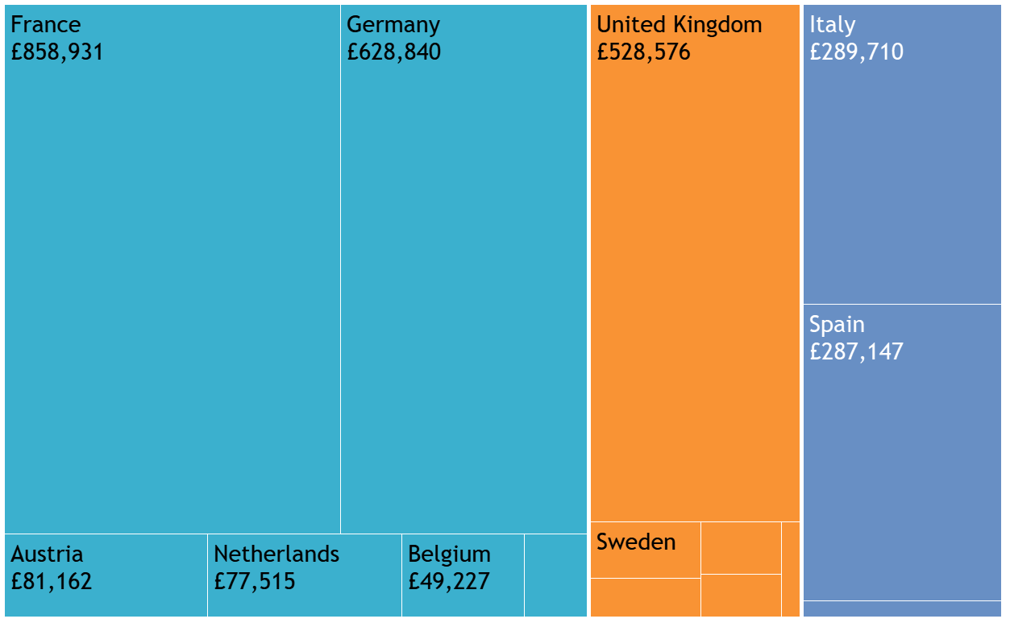

Visualization Techniques – Tree Map
Colour can be used to represent a dimension thus providing further information/categorization of each block
In this example, the colour is used to shown the Region on the country in Europe.

Slide 30
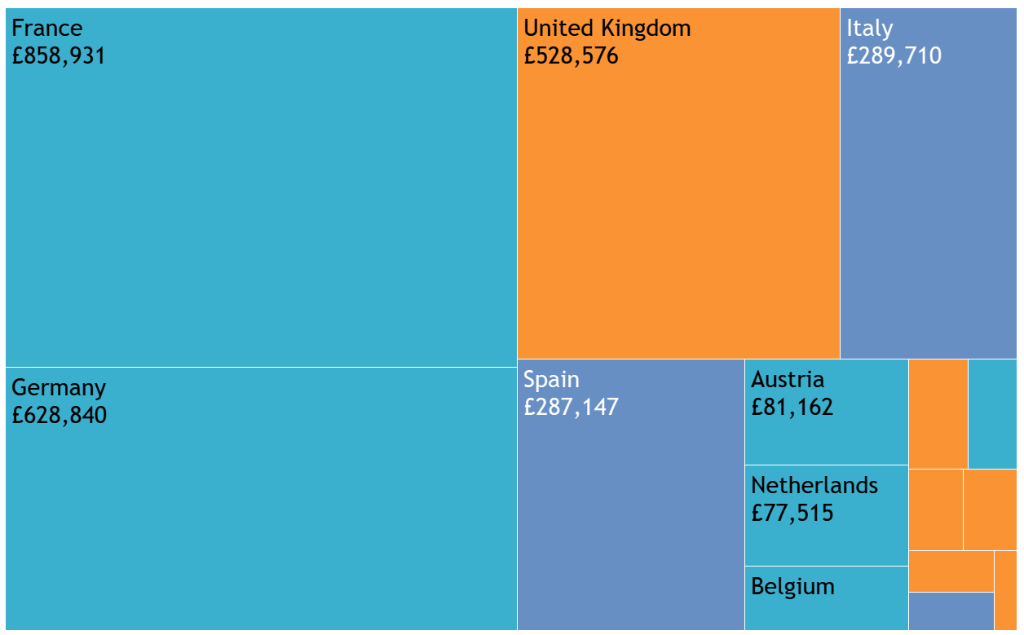
Visualization Techniques – Tree Map
Changin the sorting as to not group within each region
Allows us to cross all regions and understand most performing regions in a simpler way

Slide 31
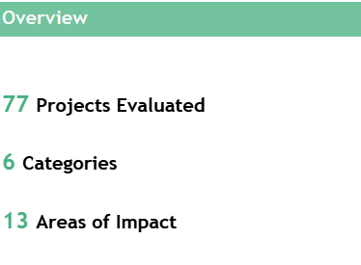
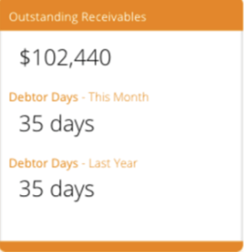
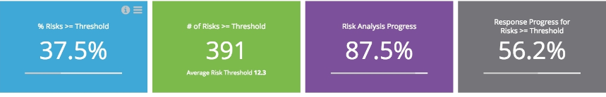
Dashboarding
KPI Sections: some examples

Slide 32
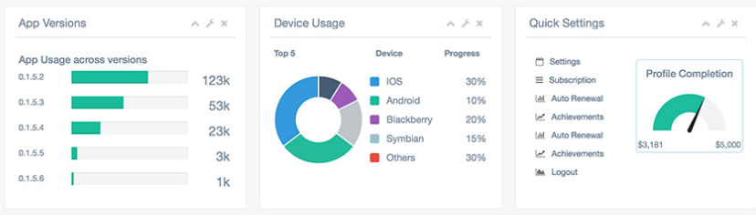
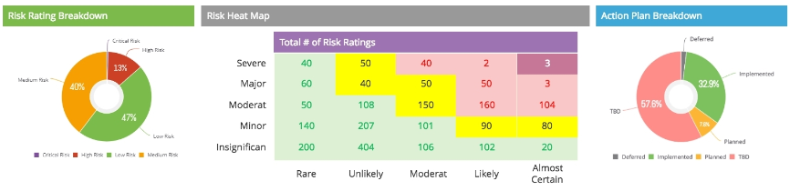
Dashboarding
Card Structure to show different breakdowns

Slide 33
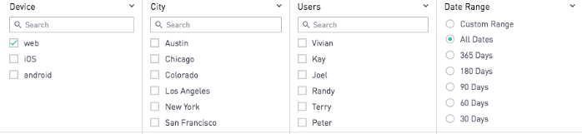

Dashboarding
Filters section allow for user to drill-down to appropriate level
Types of filters:
Single-Selection Filter: you can only chose one value at a time
Multiple Value: many values can be simultaneously included/excluded Drop-down filters Wildcard search: Filter based on specific condition. For example using a contains condition: Contains(user input)

Slide 34
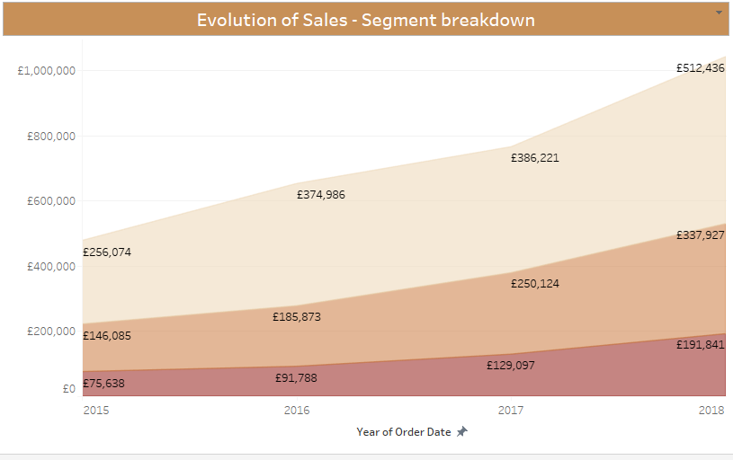
Dashboarding
Timeline view
When analysing data a chronological view usually brings greater insight and therefore should be included in a dashboard. An exception would be if the data looked at has no time dimension associated to it or the scope of our analysis is a point in time only (this is rare)
A temporal insight can be done using different techniques:
Choice of KPI’s for time comparison purpose: YoY, Last Twelve Months, Moving average, etc..
Explicit timeline chart (with appropriate granularity for analysis)
Time Series Analysis

Slide 35
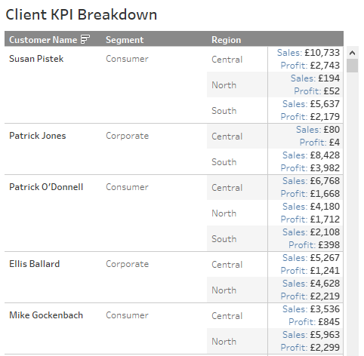
Dashboarding
Tabular view with greatest detail
Depending on what is the greatest detail that you want to allow, you should always include a table within the dashboard which includes a full breakdown by that level of detail.
This allows the user to ultimately manipulate the full data and make his/her own detailed analysis. This is key if you want your dashboard to be useful. A dashboard in which the user must then access another report/secondary data source to answer one of the core questions, is usually unsuccessful.

